Slide 1



Hybrid Boosted Model with an Approach Inspired by Mixture of Experts
Rafael Zimmermann - ITU AI/ML in 5G Challenge

Slide 2
Presentation
Pre-Processing
Merge and Aggregate
Feature Engineering
Standard Features
Temporal Features
Future Data
2. Ensemble Modeling:
Ridge Regression + XGBoost
3. Approach Inspired by Mixture of Experts
3 Experts – 1 for Objective
Gate
4. Model Workflow

Slide 3
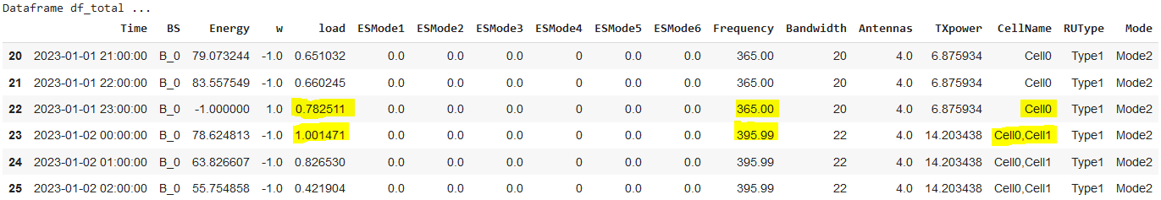
Data Merging and Aggregation
Merging
Combine Training and test and sort by BS and Time
Merge Left – (cell_level and base_station)
Aggregation
• Standard aggregation for numerical columns: 'sum’.
• Special aggregation for 'Energy', 'w', 'Frequency', 'Antennas’: ‘mean’.

Slide 4
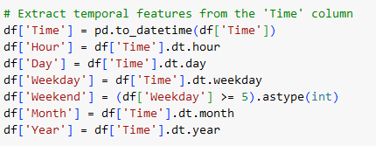
FEATURE ENGINEERING - STANDARD FEATURES
Standard Features
Date & Time: Conversion of 'Time' to datetime; extracting hour, day, month, and year.
Label Encoding: Numerical transformation of categorical columns.
Discretization: Segmenting continuous features into 10 intervals.
One-Hot Encoding: Encoding the 'RUType' column.

Slide 5
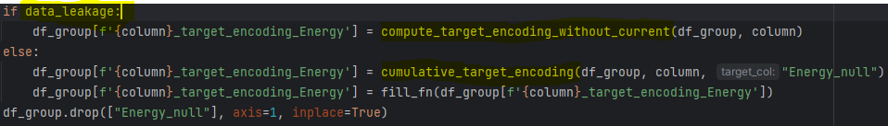
FEATURE ENGINEERING - TEMPORAL FEATURES
Column Lags:
Energy (5), Load (3), Hour (3), Day (3), ESMode6 (3), ESMode1 (3).
Target Encoding: Specifically for 'Hour' column.
Differences: Between present and past values:
Energy (1 lag), Load (2 lags), Hour (2 lags), ESMode6 (2 lags), ESMode1 (2 lags).
Generated each feature per 'BS' group and safeguarding temporal integrity.

Slide 6
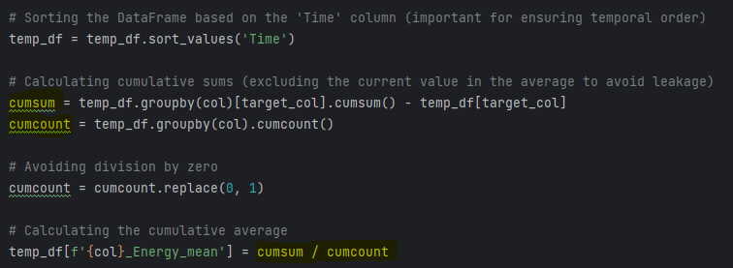
FEATURE ENGINEERING – DATA LEAKAGE
Cumulative Aggregations: When using target encoding, it's done cumulatively to avoid reviewing all data at once. This minimizes the risk of future data leakage.

Slide 7
FEATURE ENGINEERING – DATA LEAKAGE
Data Leakage Identification:
Direct visualization of future data (e.g., Lead features, BFIL null values).
Avoid direct visualization methods.
Aggregating with methods that include future data (e.g., target encoding, mean, max, min).
For aggregations, only use past data; exclude future data.
Note: Specific methods can ensure aggregations are based solely on past data.
Model | LB Private WMAPE
Without Leads, Without Global Agregation (Final Submission) | 0.069932182
Without Leads, With Global Agregation | 0.064807411
With Leads and Global Target Encoding | 0.050298939

Slide 8
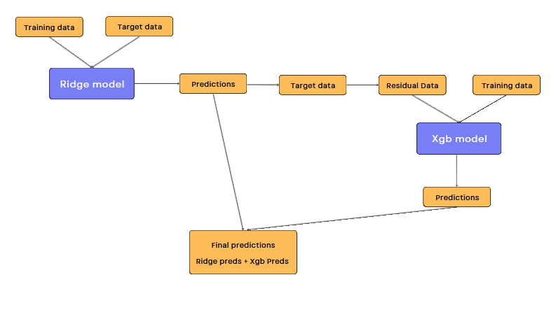
Ensemble Modeling – Boosted Hybrid Model
Ridge Regression:
Effectively identifies and maps linear trends.
Extrapolative inferences beyond initial training set.
XGBoost on Residuals:
After Ridge Regression predictions, residuals are calculated.
XGBoost is trained on these residuals to capture non-linear nuances.
Focuses on target transformation and feature clustering.
Prediction:
Starts with Ridge Regression estimates.
Adjusted by XGBoost predictions on residuals.
Sum of these predictions form the final estimate.

Slide 9
APPROACH INSPIRED BY MIXTURE OF EXPERTS
Strategy inspired by the 'Mixture of Experts' method. This approach allowed me to develop three specialized models, each catering to a specific objective.
Expert A: Temporal Focus
Objective: Capture historical seasonality.
Inputs: Emphasis on temporal feature engineering:
Lags, differences.
Load, EMS, time.
Target encoding on hour variable.
Unique Factor: Temporal features tailored for each base station.
Importance: Ensures accuracy and prevents data leakage.
Expert B: Advanced Feature Engineering
Objective: Generalize over new stations.
Inputs:
Polynomial features on 'load', 'ESMode6', 'Antennas', 'TXpower', and 'Frequency'.
K-means clustering on Base Station (BS) configurations.
Unique Factor: Hybrid method combining time-series with BS configurations.
Importance: Reduces dependency on historical data, emphasizing station settings and load.
Expert C: Streamlined Approach
Objective: Generalize over new stations configurations.
Inputs: Selection of critical attributes without overcomplexity.
Unique Factor: Simplicity often outperforms complexity.
Importance: Eliminating attributes that might lead to overfitting or historical contamination.

Slide 10
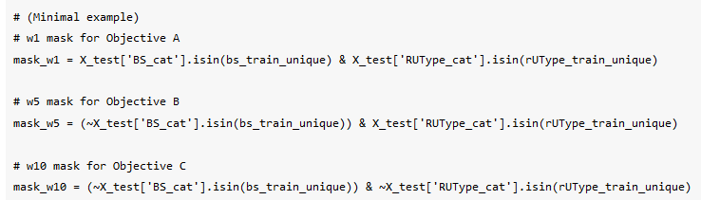
Gate
The 'Gate' in our system segments the test data into 'hot' or 'cold' using specific characteristics, such as 'BS' and 'RUType'. This segmentation allows us to choose the most appropriate 'expert' for each situation, optimizing precision and adaptability.

Slide 11
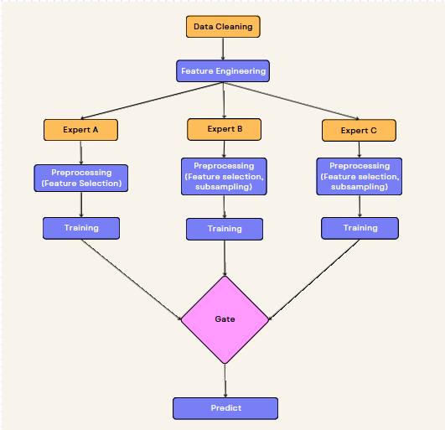
Model Workflow
Representative scheme of the model workflow, detailing the steps from data cleaning to prediction. The diagram illustrates the differentiation in the preprocessing approaches for experts A, B, and C, culminating in the decision through the "Gate" for the generation of the final forecast.

